Slide 1
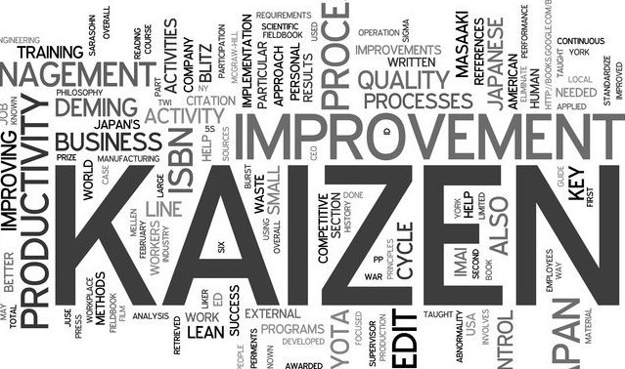
Dawn Hill CSCP, CPIM, CQE, CLSSMBB
Dawn.Hill@us.abb.com

Slide 2
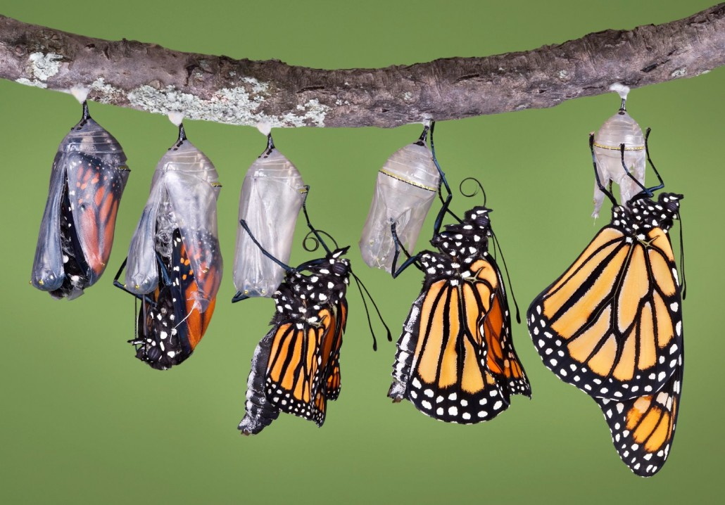
Kai
(Change)
(for the)
Zen
(Good)

Slide 4
Planning
What help or information do I need?
How to get around
Speaking the language
What to bring
What to do
Where can I get help and information?
Someone already in my circle
Outside expert
Internet, books, etc.
Who do I want to take with me?

Slide 5
Planning
Benefits of thorough planning
Good return for time and money spent
Fun and rewarding experience
Desire to do it again… and again…
Consequences of poor planning
Much time and money spent ineffectively
Poor experience
No desire to do it again

Slide 6
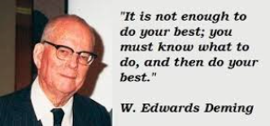
Planning
Don’t start until you know what you’re diving into

Slide 7
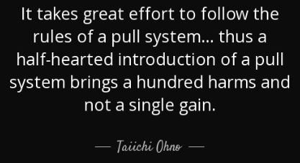
Planning
Mapping the course
Define
Measure
Analyze
Improve
Control

Slide 8
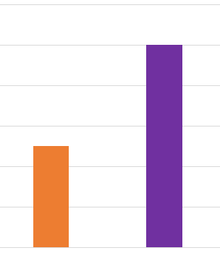
Define
Where are we starting from?
Where do we want to go?
Define the goal
Define the gap
Choose first step
Go for an easy win!
GAP

Slide 9
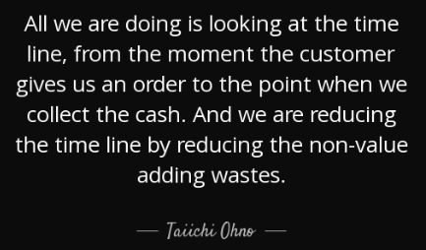
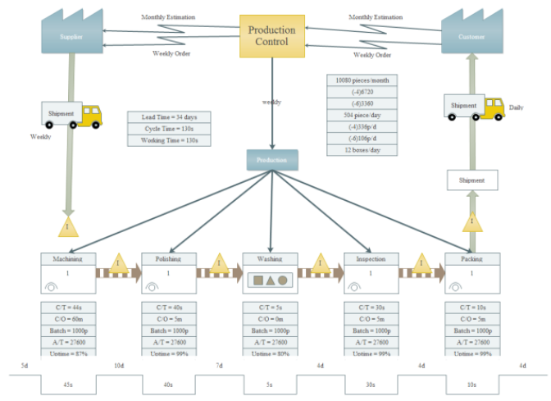
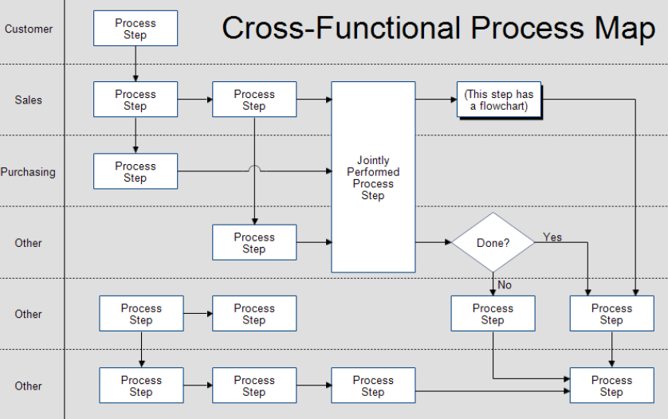
Measure
Value Stream Mapping / Process Mapping

Slide 10
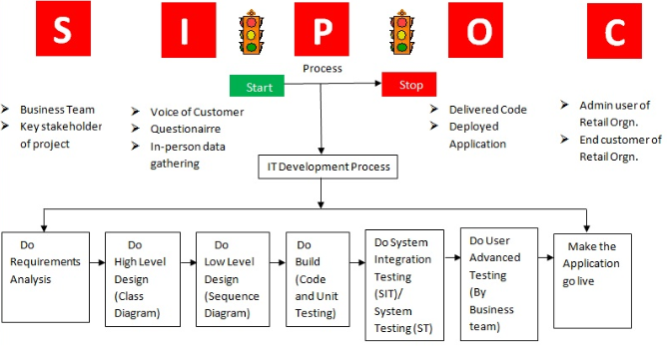
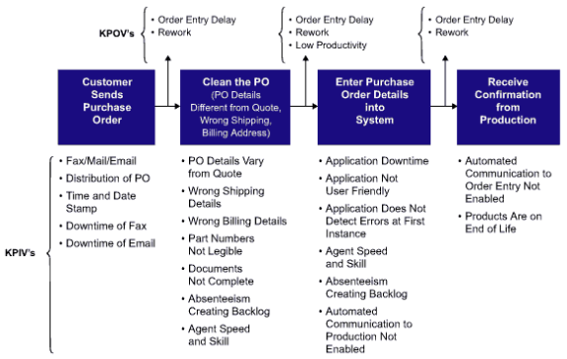
Measure
Go See – Ask Why – Show Respect

Slide 11
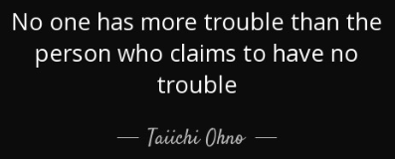
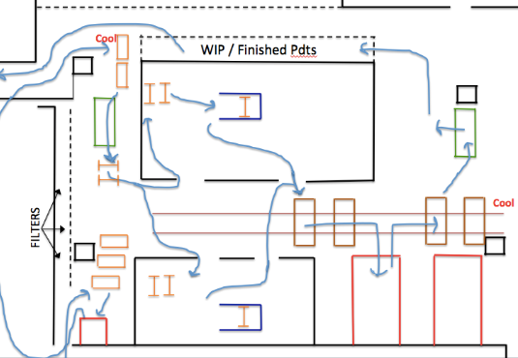
Measure
Spaghetti diagraming

Slide 12
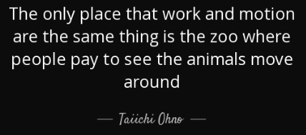
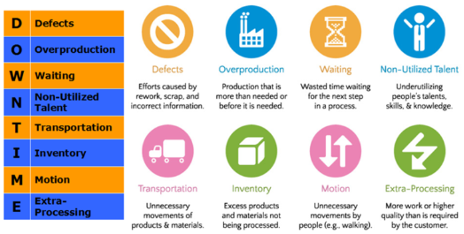
Measure
8 Wastes

Slide 13
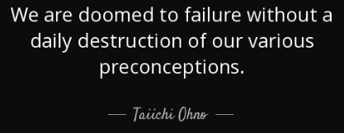
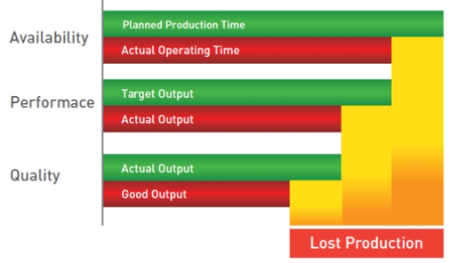
Measure
OEE (Overall Equipment Effectiveness)

Slide 14
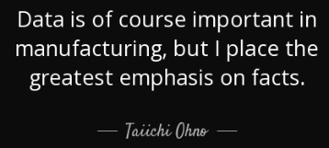
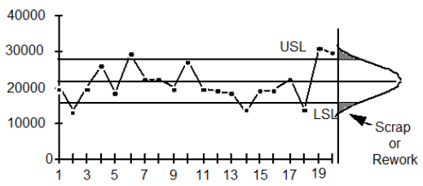
Measure
Statistical Process Control

Slide 15
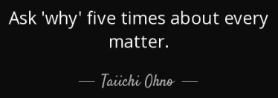
Analyze
5 Why’s

Slide 16
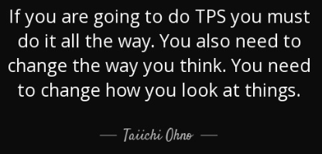
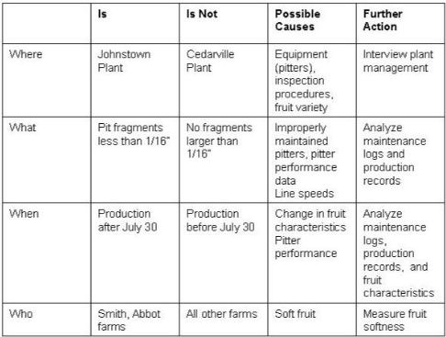
Analyze
Is / Is-Not Analysis

Slide 17
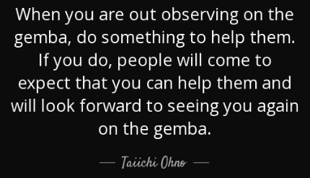
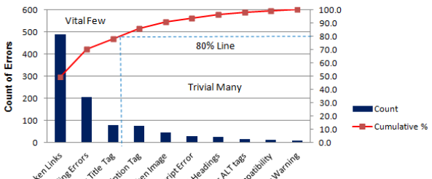
Analyze
Pareto Analysis

Slide 18
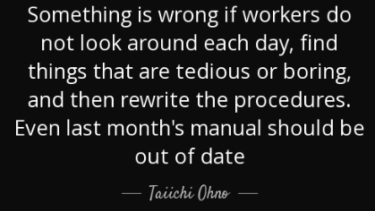
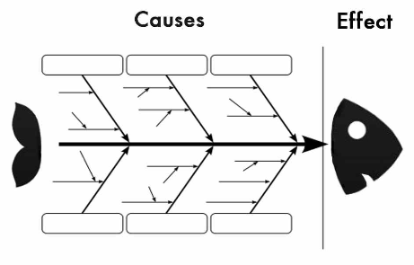
Analyze
Fishbone Diagram

Slide 19
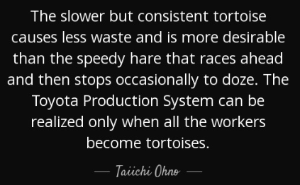
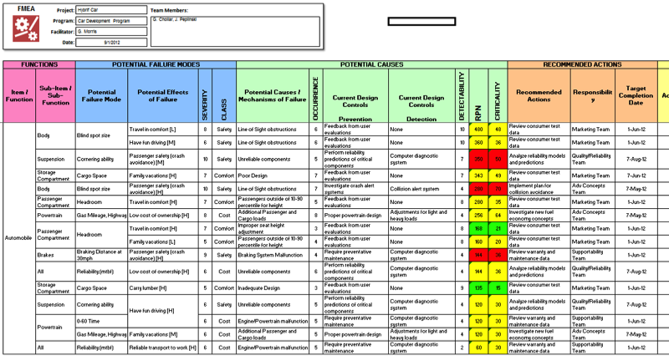
Analyze
FMEA

Slide 20
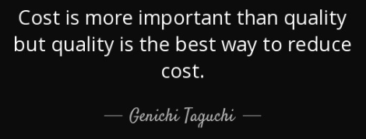
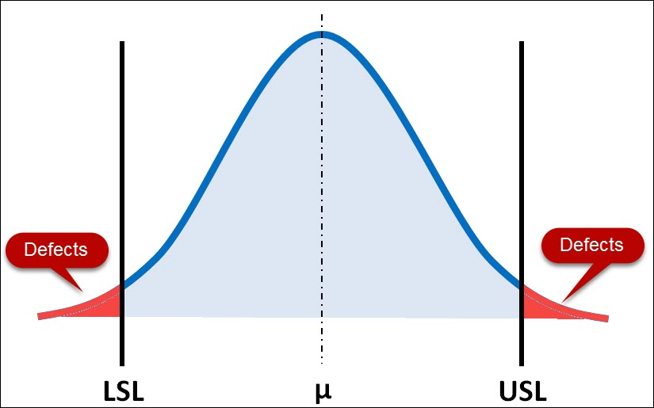
Analyze
Capability Analysis

Slide 21
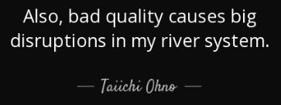
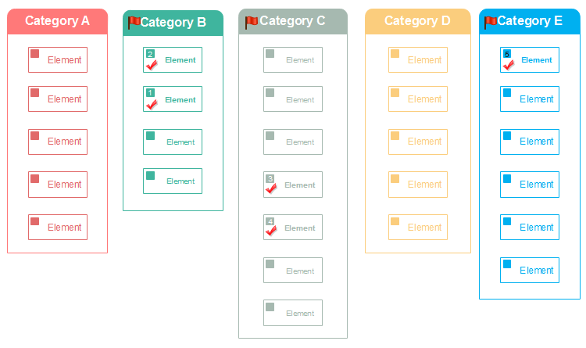
Analyze
Affinity Diagram
Brainstorm
Categorize
Vote

Slide 22
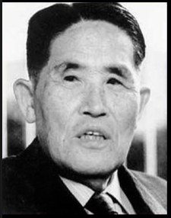
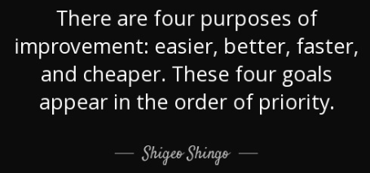
Analyze
FAST Analysis for Setup Reduction
Foresight (move to external)
Attachments (quick change)
Settings (accelerate or eliminate)
Trials and Adjustments (minimize or eliminate)

Slide 23
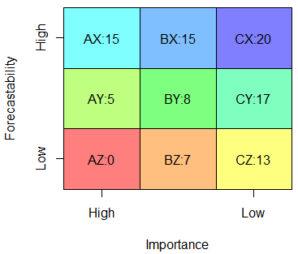
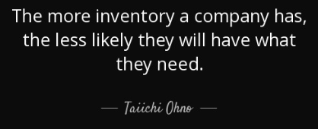
Analyze
ABC – XYZ Analysis
ABC – categorize by inventory value
XYZ – categorize by usage pattern

Slide 24
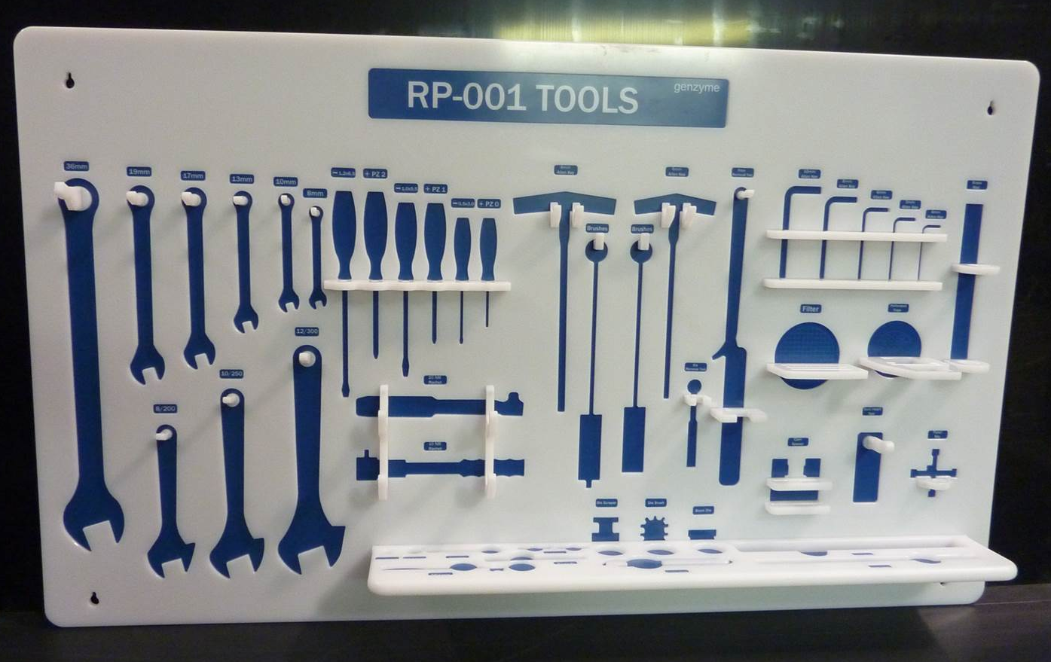
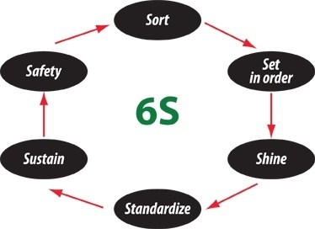
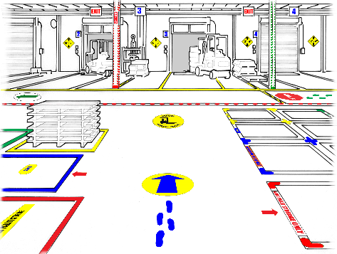
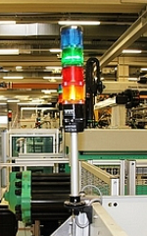
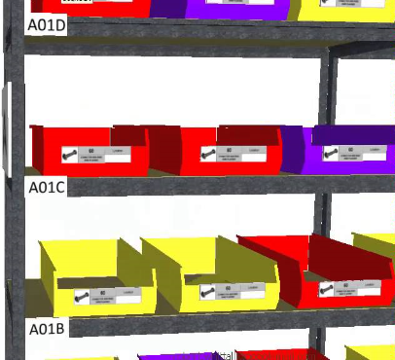
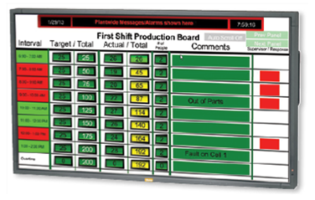
Improve
Tools
6S
Visual Factory (Andon lights, color coding, etc.)

Slide 25
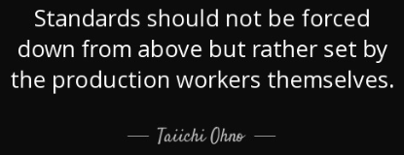
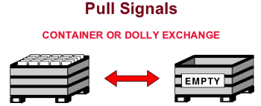
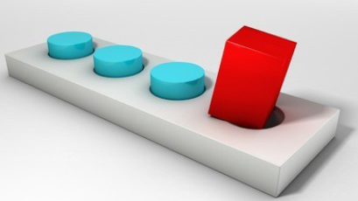
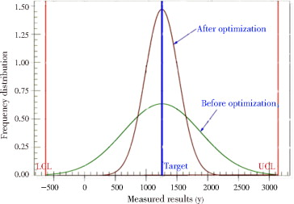
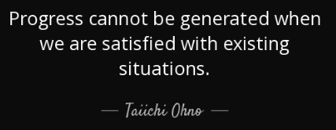
Improve
Tools
Kanban
Poka Yoke
TPM
Flow Improvement
Setup Reduction
Variation Reduction

Slide 26
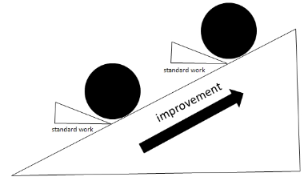
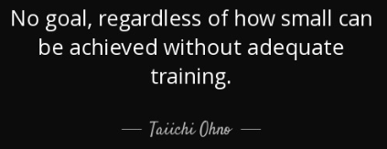
Control
Standard Work
Audits
Train / Mentor / Coach
Develop people & capabilities

Slide 27
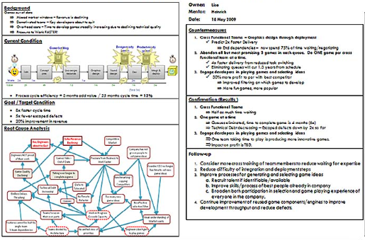
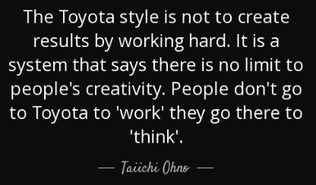
Control
Metrics boards (targets)
Communication – A3 (Publicize wins!)
Change the Culture

Slide 28
Make your workplace into a showcase that can be understood by everyone at a glance. In terms of quality, it means to make the defects immediately apparent. In terms of quantity, it means that progress or delay, measured against the plan, and is made immediately apparent. When this is done, problems can be discovered immediately, and everyone can initiate improvement plans.
Taiichi Ohno
If you are going to do kaizen continuously you've got to assume that things are a mess. Too many people just assume that things are all right the way they are. Aren't you guys convinced that the way you're doing things is the right way? That's no way to get anything done. Kaizen is about changing the way things are. If you assume that things are all right the way they are, you can't do kaizen. So change something!

